Slide 1
Collections
Lists, Sets, Maps

Slide 2
The Collection interface
Much of the elegance of the Collections Framework arises from the intelligent use of interfaces
The Collection interface specifies (among many other operations):
boolean add(E o)
boolean contains(Object o)
boolean remove(Object o)
boolean isEmpty()
int size()
Object[] toArray()
Iterator<E> iterator()
You should learn all the methods of the Collection interface--all are important

Slide 3
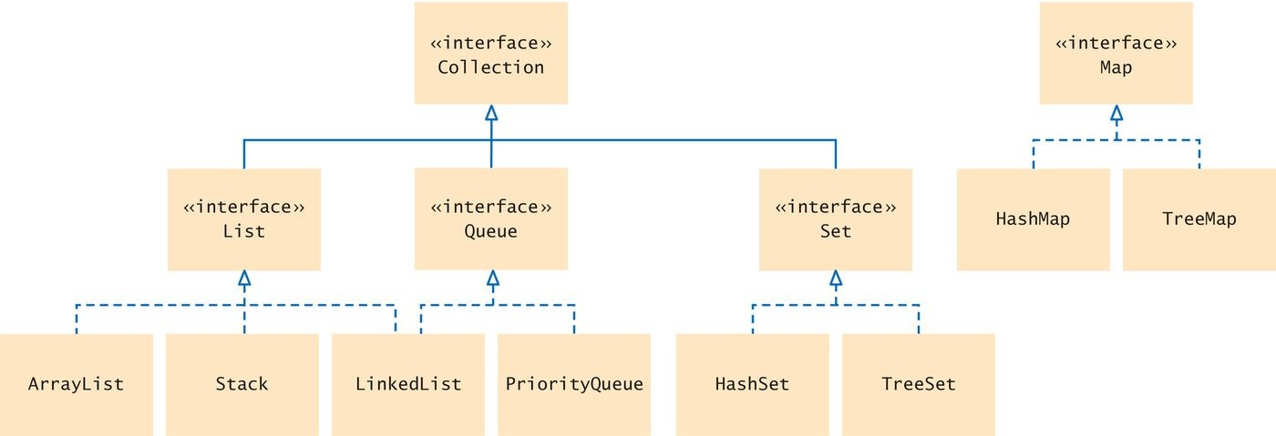
Collections Framework
A collection groups together elements and allows them to be retrieved later.
Java collections framework: a hierarchy of interface types and classes for collecting objects.
Each interface type is implemented by one or more classes
The Collection interface is at the root
All Collection class implement this interface
So all have a common set of methods

Slide 4

List
List interface
A list is a collection that remembers the order of its elements. Two implementing classes
ArrayList LinkedList
A List of Books

Slide 5

Set
Set interface
A set is an unordered collection of unique elements.
Arranges its elements so that finding, adding, and removing elements is more efficient.
Two mechanisms to do this
hash tables
binary search trees
Figure 3 A Set of Books

Slide 6

Stack
Stack
Remembers the order of elements
But you can only add and remove at the top
A Stack of Books

Slide 7

Queue
Queue
Add items to one end (the tail) and remove them from the other end (the head)
A queue of people
A priority queue
an unordered collection
has an efficient operation for removing the element with the highest priority

Slide 8
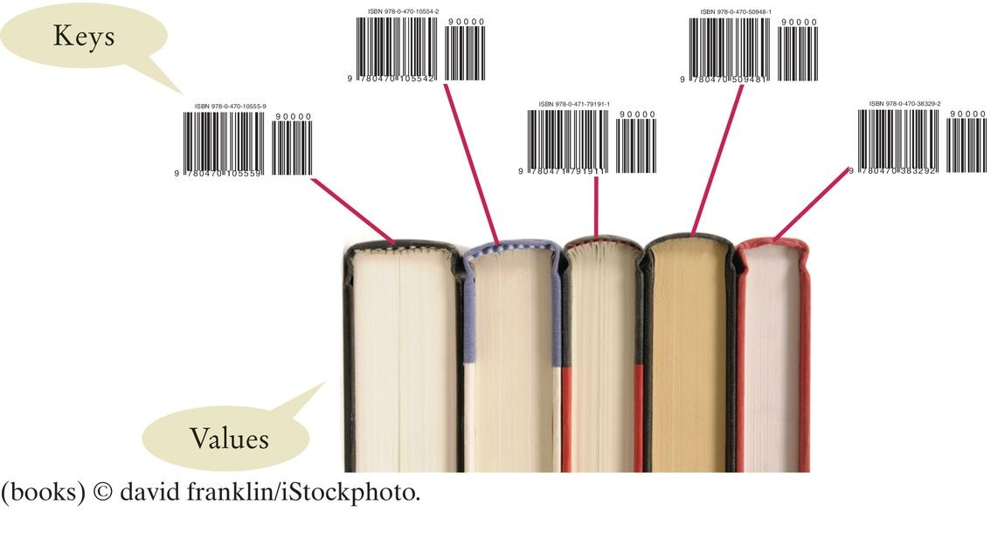
Map
Map
Keeps associations between key and value objects. Every key in the map has an associated value.
The map stores the keys, values, and the associations between them.
A Map from Bar Codes to Books

Slide 9
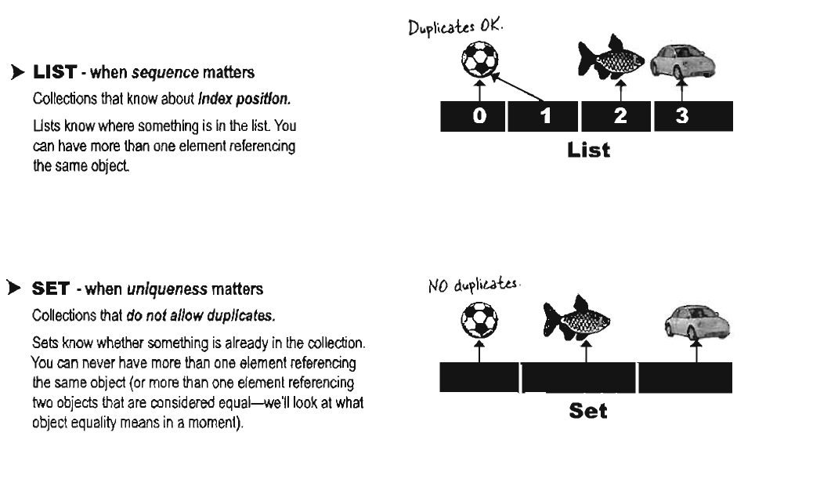

Slide 10
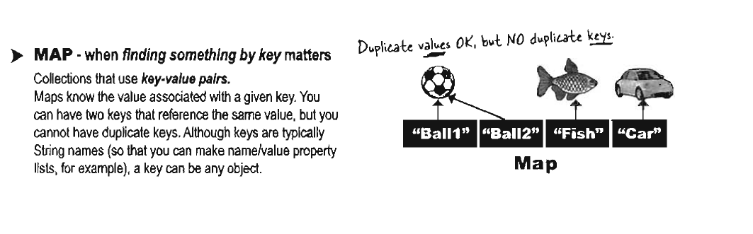

Slide 11
Sets
A set organizes its values in an order that is optimized for efficiency.
May not be the order in which you add elements.
Inserting and removing elements is more efficient with a set than with a list.

Slide 12
Sets
The Set interface has the same methods as the Collection
interface.
A set does not admit duplicates. Two implementing classes
HashSet based on hash table
TreeSet based on binary search tree
A Set implementation arranges the elements so that it can locate them quickly.

Slide 13
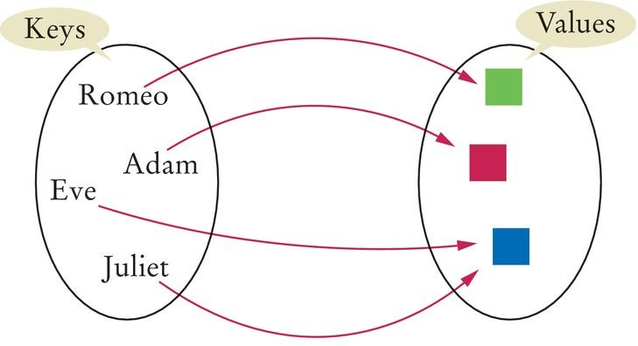
Maps
A map allows you to associate elements from a key set with elements from a value collection.
Use a map when you want to look up objects by using a key.
Figure 10 A Map
Two implementations of the Map interface:
HashMap TreeMap
Store the reference to the map object in a Map reference:
Map<String, Color> favoriteColors = new HashMap<>();

Slide 14
Maps
Use the put method to add an association:
favoriteColors.put("Juliet", Color.RED);
You can change the value of an existing association by calling
put again:
favoriteColors.put("Juliet", Color.BLUE);
The get method returns the value associated with a key:
Color julietsFavoriteColor = favoriteColors.get("Juliet");
If you ask for a key that isn't associated with any values, the get
method returns null.
To remove an association, call the remove method with the key:
favoriteColors.remove("Juliet");

Slide 15
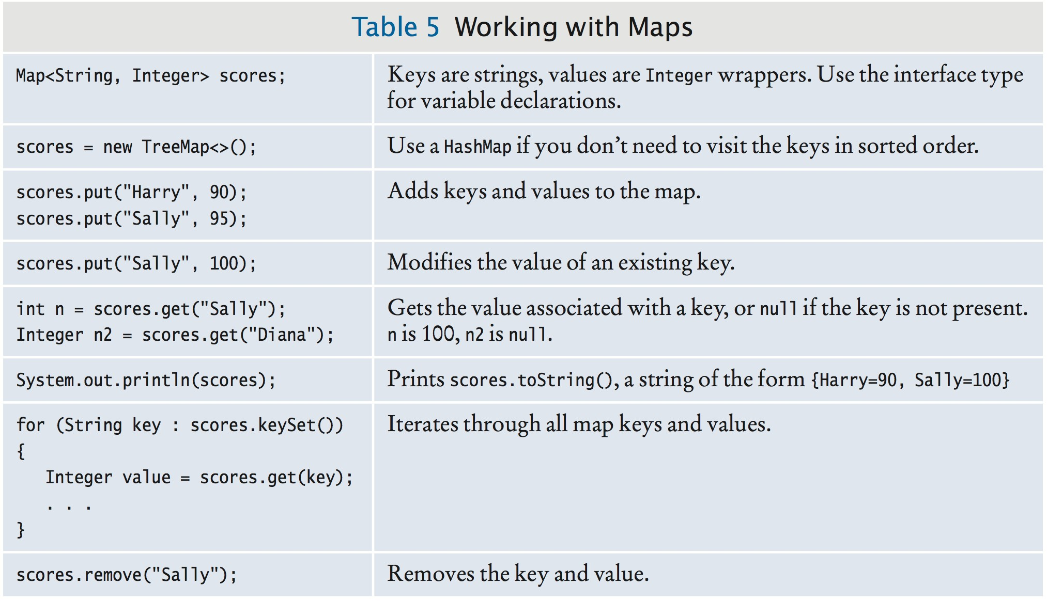
Working with Maps

Slide 16
Map
Sometimes you want to enumerate all keys in a map. The keySet method yields the set of keys.
Ask the key set for an iterator and get all keys.
For each key, you can find the associated value with the get
method.
To print all key/value pairs in a map m:
Set<String> keySet = m.keySet(); for (String key : keySet)
{
Color value = m.get(key); System.out.println(key + "->" + value);
}

Slide 17
import java.awt.Color;
import java.util.HashMap;
import java.util.Map;
import java.util.Set;
5
6
7
8
9
10
11
12
13
14
15
16
17
18
19
20
21
22
23
24
25
26
27
28 }
/**
This program demonstrates a map that maps names to colors.
*/
public class MapDemo
{
public static void main(String[] args)
{
Map<String, Color> favoriteColors = new HashMap<>(); favoriteColors.put("Juliet", Color.BLUE); favoriteColors.put("Romeo", Color.GREEN); favoriteColors.put("Adam", Color.RED); favoriteColors.put("Eve", Color.BLUE);
// Print all keys and values in the map
Set<String> keySet = favoriteColors.keySet(); for (String key : keySet)
{
Color value = favoriteColors.get(key); System.out.println(key + " : " + value);
}
}
Program Run:
Juliet : java.awt.Color[r=0,g=0,b=255] Adam : java.awt.Color[r=255,g=0,b=0] Eve : java.awt.Color[r=0,g=0,b=255] Romeo : java.awt.Color[r=0,g=255,b=0]

Slide 18
import java.util.*;
public class Test {
public static void main(String[] args)
{
//map to hold student grades
Map<String, Integer> theMap = new HashMap<String, Integer>();
theMap.put("Korth, Evan", 100);
theMap.put("Plant, Robert", 90);
theMap.put("Coyne, Wayne", 92);
theMap.put("Franti, Michael", 98);
theMap.put("Lennon, John", 88);
System.out.println(theMap);
System.out.println("--------------------------------------");
System.out.println(theMap.get("Korth, Evan"));
System.out.println(theMap.get("Franti, Michael"));
}
}

Slide 19
Utilities
The Collections class provides a number of static methods for fundamental algorithms
Most operate on Lists, some on all Collections
Sort, Search, Shuffle
Reverse, fill, copy
Min, max
Wrappers
synchronized Collections, Lists, Sets, etc
unmodifiable Collections, Lists, Sets, etc

Slide 20
Reading
https://docs.oracle.com/javase/tutorial/collections/interfaces/collection.html
Chapter 16 Head First Java

